Slide 1

Replication: Personal Economic Shocks and Public Opposition to Unauthorized Immigration
Module: Applied Statistics – II
Faculty: Jeffrey Ziegler
Programme: MSc. ASDS (‘23-24)
Original authors:
Daniel J. Hopkins
Yotam Margalit
Omer Solodoch
Replication by:
Shekhar Kedia

Slide 2
About the research
Aim, data used and key findings from the original research
Aim: To understand how negative economic shocks (both personal and labour market) heighten public opposition to immigration
Literature suggests economic circumstances & levels of labour market competition have little bearing on citizens’ immigration attitudes
Personal economic shocks have potential to trigger the threatened, anti-immigration responses
Data: Panel study tracking a large, representative adult Americans from 2007-20. However, for analysis data from 2012 is considered (n = 2,149).
Key findings:
Adverse personal economic shocks, especially job losses and income shock, spurred opposition to unauthorized immigration
Effects more concentrated among white and male Americans

Slide 3
Replication
Using the 7-point scale dependent variable and running a multinomial ordered logit model
Key objectives of replication:
Establish credibility to the researchers original work
Learn how to perform various statistical analysis on primary data
Add value to the research by making contributions
Research uses a binary dependent variable to map whether respondent support deportation of unauthorised immigrants or not.
Original variable captures responses on a 7-point scale ranging from 1 (‘Return illegal immigrants to their native countries’) to 7 (‘Create a pathway to U.S. citizenship for illegal immigrants’).
Contribution: Original 7-point scale variable used as the dependent variable in a multinomial ordered logit model to measure the effect.

Slide 4
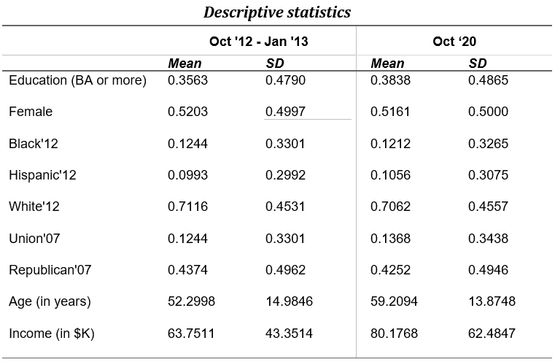
Descriptive summary
Checking that the broad demographic trends across the two rounds of survey remain the same
(N = 2,149)
(N = 1,055)
Respondents in the latest Oct’20 survey demographically similar to respondents in the Oct’12 survey: Panel remained consistent
12% Black, 11% Hispanic, and 71% White people, with 38% reporting a college degree.

Slide 5
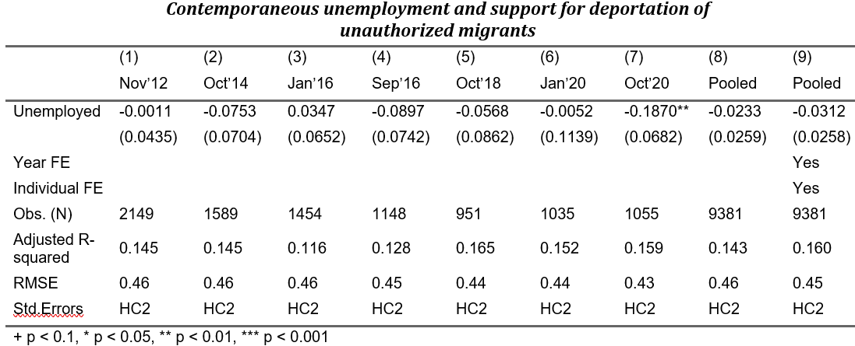
Results (author 1/3)
Model: Unemployment and support for deportation of unauthorised migrants
We find no evidence to suggest that if respondent is unemployed, it is associated with them supporting deportation of unauthorised migrants (for the full model)
N.B.: Outcome variable is a binary indicator that equals 1 if the respondent supports deporting unauthorized migrants, and 0 otherwise. All regressions control for respondents’ age, race, gender, level of education, income employment status (retired, disabled or other), and partisanship (an indicator variable for Republicans). Robust standard errors in parentheses.

Slide 6
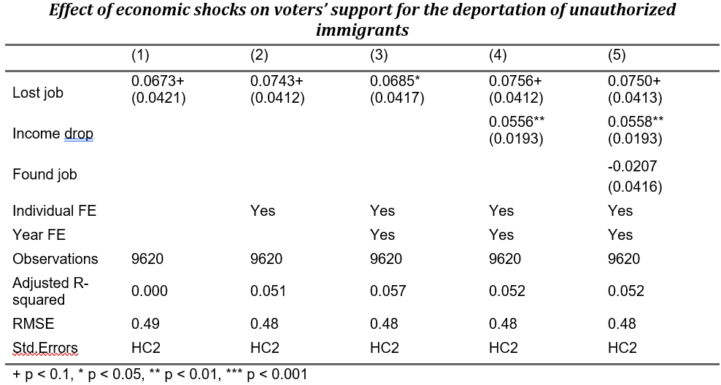
Results (author 2/3)
Model: Effect of economic shocks on support for deportation of unauthorized migrants
If respondent has lost job recently or experienced a drop in income (either personal or family), it affects opposition to unauthorized immigration (for all model specification)
Respondents who recently lost their job are 7.5 pp more supportive of deporting
Major income drop (of at least 25%) associated with 5.5 pp increase in support for deporting
If respondents recently found a job, negatively associated with support for deporting (not statistically reliable)

Slide 7
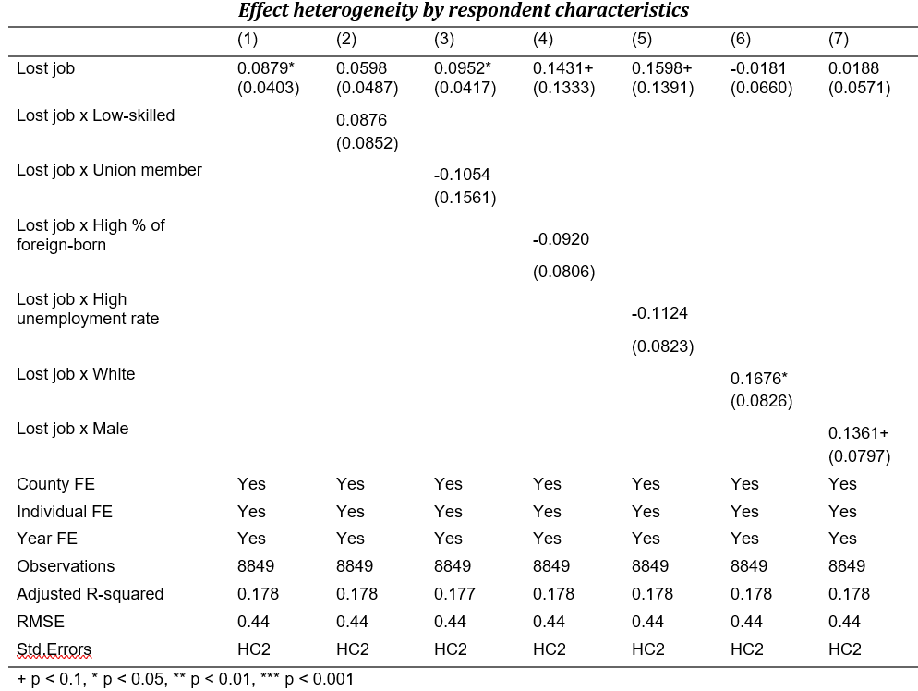
Results (author 3/3)
Model: Effect heterogeneity by respondent characteristics
No evidence of heterogeneous effects across respondents differentiated by skill level or union membership
No evidence found in case of counties with higher % of foreign born or unemployment rate
White respondents who have recently lost jobs: 16.76 pp more opposed
Also, male respondents: 13.61 pp more opposed to unauthorised immigration
N.B.: Outcome variable is a binary indicator that equals 1 if the respondent supports deporting unauthorized migrants, and 0 otherwise. The linear probability models in columns 2–7 interact with unemployment shocks with indicator variables denoting the different groups of respondents. All regressions control for the constitutive terms of the interaction with job loss and age, income, employment status (retired, disabled or other) and partisanship. Robust standard errors in parentheses.

Slide 8
Results (contribution 1/2)
Model: Unemployment and support for deportation of unauthorised migrants
Covariate | Value | Std. error | t value | p value
UNEMPLOYED | 0.1969834 | 0.006209460 | 31.723114 | 0.0000
1|2 | 118.1841585 | 0.011244808 | 10510.10954 | 0.0000
2|3 | 118.6608454 | 0.019175913 | 6188.015281 | 0.0000
3|4 | 119.1131872 | 0.023271951 | 5118.315431 | 0.0000
4|5 | 119.9918159 | 0.028902471 | 4151.610931 | 0.0000
5|6 | 120.6035795 | 0.032354387 | 3727.580396 | 0.0000
6|7 | 121.2576560 | 0.036534422 | 3318.997560 | 0.0000
One unit change in UNEMPLOYED variable that is moving from ”unemployed” to ”employed” is associated with an increase of 0.197 log odds on average for a one step change of path variable which captures support for deportation on a 7-point scale ranging from 1 (‘Return illegal immigrants to their native countries’) to 7 (‘Create a pathway to U.S. citizenship for illegal immigrants’) holding all other covariates constant.
So, we find sufficient evidence to say that unemployed respondents oppose the deportation of unauthorized immigrants.
N.B.: All regressions control for respondents’ age, race, gender, level of education, income employment status (retired, disabled or other), year and partisanship (an indicator variable for Republicans).

Slide 9
Results (contribution 2/2)
Model: Effect of economic shocks on support for deportation of unauthorized migrants
Covariate | Value | Std. error | t value | p value
LOST_JOB | -0.213567659 | 0.151907476 | -1.4059062 | 0.1598
income_shock2 | -0.207933736 | 0.069856838 | -2.9765695 | 0.0029
FOUND_JOB | 0.133809587 | 0.153516189 | 0.8716318 | 0.3834
1|2 | -0.428223520 | 0.142333975 | -3.0085826 | 0.0026
2|3 | 0.017343994 | 0.142232843 | 0.1219409 | 0.9029
3|4 | 0.426003191 | 0.142231108 | 2.9951478 | 0.0027
4|5 | 1.220687717 | 0.142668735 | 8.5560983 | 0.0000
5|6 | 1.778897021 | 0.143251141 | 12.4180304 | 0.0000
6|7 | 2.383304500 | 0.144104814 | 16.538688 | 0.0000
One unit change in income_shock2 variable that is experiencing a major income drop (of at least 25%) is associated with a decrease of 0.207 log odds on average for a one step change of path variable which captures support for deportation on a 7-point scale ranging from 1 (‘Return illegal immigrants to their native countries’) to 7 (‘Create a pathway to U.S. citizenship’) holding all other covariates constant.
Coefficients for recent job lost and finding job is not statistically reliable.
N.B.: All regressions control for respondents’ age, race, gender, level of education, income employment status (retired, disabled or other), year and partisanship (an indicator variable for Republicans).

Slide 10

Conclusion
The research findings were successfully replicated
Research shows that labour market factors like unemployment rate and unemployed respondents and counties with high % of foreign-born do not affect opposition towards unauthorised immigrants
However personal economic factors like recent job loss or income shock (of at least 25%) is associated with negative sentiment towards unauthorised immigrants and support their deportation
Furthermore, from the heterogeneity model we observe that white respondents and male respondents who have faced recent job loss are more likely to support deportation of unauthorized immigrants
Contribution exercise shows mostly similar trends (as with authors work)
However, effects of unemployed respondents was found to be different

Slide 11
Thank You

